Slide 1

Restaurant Rating Prediction
Domain: E Commerce
Komal Reddy Koukuntla

Slide 2
Objective :
The main goal of this project is to perform extensive Exploratory Data Analysis(EDA) on the Zomato Dataset and build an appropriate Machine Learning Model that will help various Zomato Restaurants to predict their respective Ratings based on certain features.
Benefits :
Gives Better insight of Restaurant
Predict the rating of restaurant by analyzing certain features

Slide 3
Data Sharing Agreement
File name ( Zomato.csv)
Number of columns 17
Number of rows 56251
Column Data Type : String (12), Boolean (2), Integer(1), other (2)

Slide 4
Architecture
Start
Data (batches) For training
Data Validation
Data Transformation
Data Preprocessing
Get the model for data
Export Prediction to csv
Data (batches) For prediction
Deployment
Model Saving
Hyperparameter tuning
End

Slide 5
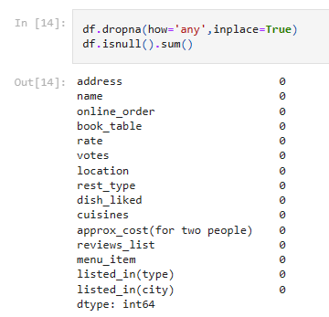
Data Validation and Data Transformation
Removing Null values

Slide 6

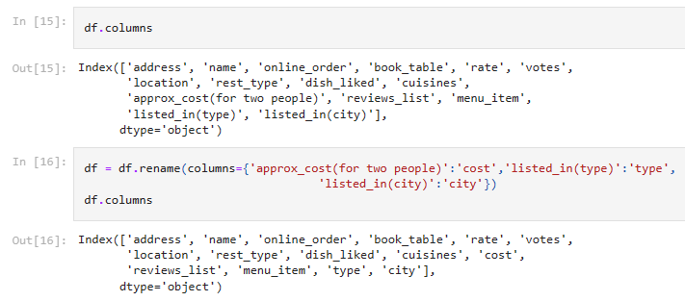
Remove unnecessary columns (features)
Remove duplicates in dataset
Renaming columns according to our convenience

Slide 7
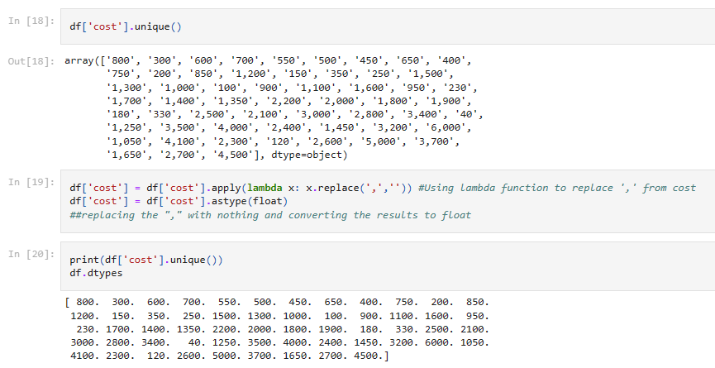
Changing datatype of cost as float

Slide 8
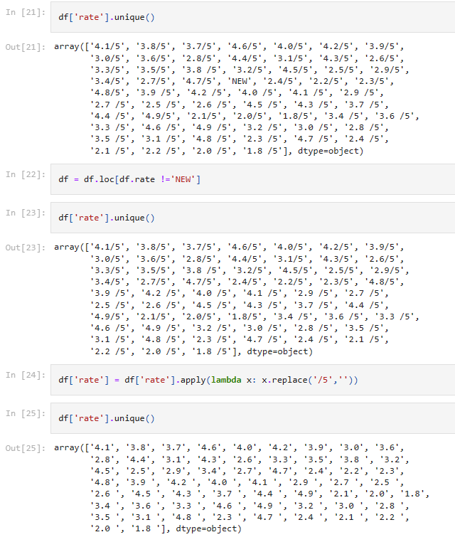
Removing '/5' from Rates and getting rid of 'NEW' as an entry

Slide 9
Model Training
Data preprocessing:
Performing EDA to get insight of data like identifying distribution , outliers, trend among data (most famous restaurants, top liked foods) etc.
Check for null values in the columns. If present impute the null values.
Encode the categorical values with numeric values.

Slide 10
Model Selection:
Built models using Linear Regression, Random Forest, ExtraTree Regressor
ExtraTree Regressor is chosen as its r2 score is high (0.9325151755043354)

Slide 11
Prediction
Model is trained in sets (Train_Test_Split) 30% of data for testing whereas 70% is for training
The sets are preprocessed and data is predicted using ExtraTree Regressor model
The predicted data is saved in Zomata_df_komal.csv

Slide 12
Q & A
What’s the source of data ?
The data for training is provided by the client in multiple batches and each batch contain multiple files.
What was the type of data ?
The data was the combination of numerical and Categorical values
What’s the complete flow you followed in this Project ?
Refer Slide no 4 for better Understanding.

Slide 13
After the File validation what you do with incompatible file or files which didn’t pass the validation ?
Files like these are moved to the Achieve Folder and a list of these files has been shared with the client and we removed the bad data folder.
How logs are managed ?
We are using different logs as per the steps that we follow in validation and modeling like File validation log, Data Insertion, Model Training log, prediction log etc
What techniques were you using for data pre-processing ?
-> Removing unwanted attributes.
-> Visualizing relation of independent variables with each other and output variables.
-> Checking and changing Distribution of continuous values.
-> Removing outliers
-> Cleaning data and imputing if null values are present.
-> Converting categorical data into numeric values.

Slide 14
How training was done or what models were used ?
Model is trained in sets (Train_Test_Split) 30% of data for testing whereas 70% is for training
The sets are preprocessed and data is predicted using ExtraTree Regressor model
The predicted data is saved in Zomata_df_komal.csv
How Prediction was done ?
The testing files are shared by the client. We Performed the same life cycle on the provided dataset. Then, on the basis of dataset, model is loaded and prediction is performed. In the end we get the accumulated data of predictions.

Slide 15
What are the different stages of deployment?
First, the scripts are stored on GitHub as a storage interface.
The model is first tested in the local environment, and hosted locally .

